Slide 1

Hardware System Design (Week 5) Verilog Design 4
April 14, 2020
Sungjoo Yoo
Computing Memory Architecture Lab.
CSE, SNU
http://cmalab.snu.ac.kr

Slide 2

Weekly Schedule
W1 17 Application (deep learning on FPGA)/SW app (MNIST/CIFAR)
W2 25 Verilog 1 Basics/Vivado tutorial (verification level of HW design)
W3 31 Verilog 2 Combinational circuits (Video pre-view homework + TA Q&A)/Simple adder using dsp (V+V, Verilog intro)
W4 4/7 Verilog 3 Sequential circuits/V*V processing element (PE) design 1
W5 14 Verilog 4 Design example & synthesizable code/V*V processing element (PE) design 2
W6 21 Intro to Zynq & MV accelerator design/Zynq FPGA & synthesis, continue VV design & start MV accelerator design
W7 28 Mid-term exam cancelled. Main memory (physical & virtual)/OS+FPGA (HOST~DEVICE) communication & MV design 2
W8 5/5 (Children’s day) Optional lab session is provided in lecture and lab hour
W9 12 Bus and DMA (Video pre-view + TA Q&A)/custom IP & MV design 3
W10 19 Convolution lowering and matrix multiplication accelerator/Convolution lowering (V0)
W11 26 Advanced deep learning #1 quantization for low precision computation/V0+DMA+8b
W12 6/2 Advanced deep learning #2 zero skipping/V0+DMA+8b+zero-skipping 1
W13 9 Lecture summary/V0+DMA+8b+zero-skipping 2
W14 16 Final exam/Term project (V0+DMA+8b+zero) submission
Notes:
In our schedule, we design the hardware accelerator for four weeks as the blue part shows.

Slide 3
Agenda
Lecture
PE controller overview
Synthesizable Verilog code
Logic optimization review
Introduction to the lab on Week 5
Designing the PE controller

Slide 4
Final Project Overview: Matrix Multiplication IP
W5 (pe_controller)
MY_IP
PS
W4 (pe)
Processing Element (PE)
DOUT
CTRL
[32:0] REG[0:127] (BRAM inference)
W2~W3
Float32 MUL+ACC
DIN
A
OUT
AXI_SLAVE INTERFACE
B
ADDR
OUT
C
TRUE DP
BRAM
2-cyc
RESET
BRAM
INTERFACE
FSM
Shift(16)
DOUT
ADDR
[32:0] REG[0:127] (BRAM inference)
DIN
COUNTER

Slide 5
Processing Element (PE) for Dot Product (V*V)
Two step operations for dot product
Step 1
Testbench writes the data of weight matrix to the internal memory (peram) via ‘addr’ and ‘din’.
64 32bit data are written
Step 2
Testbench writes 64 data of vector via ‘ain’ and ‘addr’
After that, PE provides the output via ‘dout’
my_pe
dout
dvalid
ain
MAC
32b
32b
valid
Testbench
we
32b
Matrix (M)
Vector (V)
addr
6b
peram
din
32b
Notes:
The figure on the left shows the basic structure of processing element.
The multi-bit signals are shown in bold and thick arrows.
As explained on the right of this slide,
There are two execution steps in the PE.
In step 1, we write data (in fact, the elements of matrix in matrix-vector multiplication) to the internal memory, i.e., peram[]. For this operation we set ‘we’ to ‘1’.
In step 2, we do computation where the MAC unit takes three inputs, one from peram[], another from the input port ain, and the other from its own output (for accumulation). For this operation, we set ‘we’ to ‘0’.
Let’s see how each step works in the following slides.

Slide 6
PE Controller in Week 5
PE controller enables PE to perform two-step operations for dot product
Step 1
Testbench writes the data of weight matrix to the internal memory (peram) via ‘addr’ and ‘din’.
64 32bit data are written
Step 2
Testbench writes 64 data of vector via ‘ain’ and ‘addr’
After that, PE provides the output via ‘dout’
pe_controller
my_pe
start
Control
function, memory
& connection
dout
done
dvalid
aclk
ain
valid
areset_n
we
raddr
Matrix (M)
Vector (V)
addr
rddata
wrdata
din
Notes:
The figure on the left shows the basic structure of processing element.
The multi-bit signals are shown in bold and thick arrows.
As explained on the right of this slide,
There are two execution steps in the PE.
In step 1, we write data (in fact, the elements of matrix in matrix-vector multiplication) to the internal memory, i.e., peram[]. For this operation we set ‘we’ to ‘1’.
In step 2, we do computation where the MAC unit takes three inputs, one from peram[], another from the input port ain, and the other from its own output (for accumulation). For this operation, we set ‘we’ to ‘0’.
Let’s see how each step works in the following slides.

Slide 7
PE Controller
Matrix (M)
Vector (V)
PE controller consists of PE, FSM and global BRAM
PE controller takes 32 inputs (data[0]~data[31]) from testbench
PE controller writes the former 16 data (data[0]~data[15]) on local register (peram) in PE, and the latter 16 data (data[16]~data[31]) on global BRAM on PE controller
FSM controls PE to calculate inner product (e.g., data[0]*data[16] + data[1]*data[17]+ … + data[15]*data[31]) with several states
Testbench
PE controller
PE
globalmem
MAC
16 data
32b
32b
16 data
32b
6b
FSM
peram
32b
16 data

Slide 8
States in FSM
S_IDLE:
Idle state. Starts operation with state transition to S_LOAD, when input ‘start==1’.
S_LOAD:
Loads 16 data into local memory in PE and load 16 data into global BRAM. After data loading, state moves to S_CALC.
S_CALC:
Calculate “inner product” with 16 data from local memory of PE, 16 data from global memory. After calculation, state moves to S_DONE.
S_DONE:
Gives ‘done’ as 1. After 5 cycles, state moves to S_IDLE

Slide 9
Idle state
Matrix (M)
Vector (V)
Testbench
PE controller
start
PE
done
aclk
MAC
globalmem
areset_n
32b
32b
32b
raddr
6b
peram
rddata
32b
wrdata

Slide 10
Load state
Matrix (M)
Vector (V)
Testbench
PE controller
start
PE
done
aclk
MAC
globalmem
areset_n
32b
32b
32b
raddr
6b
peram
rddata
32b
wrdata
16 data

Slide 11
Processing Element (PE): Step 1
Step 1
Testbench writes the data of weight matrix to the internal memory (peram) via ‘addr’ and ‘din’.
64 32bit data (matrix elements) are written
Write enable, we = ‘1’
my_pe
dout
dvalid
ain
MAC
32b
32b
valid
Control
logic
we
32b
‘1’
Matrix (M)
Vector (V)
addr
6b
peram
din
32b
Notes:
In step 1, we write matrix elements to the local register, peram.
To do that, we set ‘we’ to ‘1’.
We also set addr and din to write data to peram.
peram has 64 elements. Thus, we will perform write operations 64 times while incrementing ‘addr’ and providing new data to ‘din’.

Slide 12
Load state
Matrix (M)
Vector (V)
Testbench
PE controller
start
PE
done
aclk
MAC
globalmem
areset_n
32b
32b
32b
raddr
16 data
6b
peram
rddata
32b
wrdata

Slide 13
Calc state
Matrix (M)
Vector (V)
Testbench
PE controller
start
PE
done
aclk
MAC
globalmem
areset_n
32b
32b
16 data
32b
raddr
16 data
6b
peram
rddata
32b
wrdata

Slide 14
Processing Element (PE): Step 2
Step 2
Testbench writes 64 data of vector via ‘ain’ and ‘addr’
valid = ‘1’, we = ‘0’
my_pe
dout
dvalid
ain
MAC
32b
32b
valid
Control
logic
‘1’
we
32b
‘0’
Matrix (M)
Vector (V)
addr
6b
a
b
c
d
peram
1
din
2
32b
3
4
Notes:
In Step 2, we perform computation, i.e., the MAC performs dot-product operation between a set of matrix elements (in peram) and a set of vector elements provided to ‘ain’.
The testbench (later, our accelerator design which instantiates PEs) will provide 64 vector elements via ‘ain’.
First, we (=the testbench) need to set ‘we’ to ‘0’ and ‘valid’ to ‘1’ as the slide shows.
Then, the testbench needs to provide 64 data via ‘ain’ while incrementing ‘addr’.
In Step 2, for each ‘addr’, peram provides the associated data, e.g., if addr = 10, peram[10] is provided to MAC.

Slide 15
Processing Element (PE): Step 2
Step 2
Testbench writes 64 data of vector via ‘ain’ and ‘addr’
In cycle 1, the first input pair of matrix and vector elements, a and 1 is provided to the MAC unit
my_pe
dout
dvalid
ain
1
MAC
32b
32b
valid
a
Control
logic
‘1’
we
32b
‘0’
Matrix (M)
Vector (V)
addr
6b
a
b
c
d
peram
1
din
2
32b
3
4
Notes:
In Step 2, we perform computation, i.e., the MAC performs dot-product operation between a set of matrix elements (in peram) and a set of vector elements provided to ‘ain’.
The testbench (later, our accelerator design which instantiates PEs) will provide 64 vector elements via ‘ain’.
First, we (=the testbench) need to set ‘we’ to ‘0’ and ‘valid’ to ‘1’ as the slide shows.
Then, the testbench needs to provide 64 data via ‘ain’ while incrementing ‘addr’.
In Step 2, for each ‘addr’, peram provides the associated data, e.g., if addr = 10, peram[10] is provided to MAC.

Slide 16
Processing Element (PE): Step 2
Step 2
Testbench writes 64 data of vector via ‘ain’ and ‘addr’
In cycle 1, the first input pair of matrix and vector elements, a and 1 is provided to the MAC unit
In cycle 2, 2nd input pair of b and 2 is provided. Note that the partial sum, Psum is also an input to the MAC unit and accumulated with the new product
my_pe
dout
Psum (=a*1)
dvalid
ain
2
MAC
32b
32b
valid
b
Control
logic
‘1’
we
32b
‘0’
Matrix (M)
Vector (V)
addr
6b
a
b
c
d
peram
1
din
2
32b
3
4
Notes:
In Step 2, we perform computation, i.e., the MAC performs dot-product operation between a set of matrix elements (in peram) and a set of vector elements provided to ‘ain’.
The testbench (later, our accelerator design which instantiates PEs) will provide 64 vector elements via ‘ain’.
First, we (=the testbench) need to set ‘we’ to ‘0’ and ‘valid’ to ‘1’ as the slide shows.
Then, the testbench needs to provide 64 data via ‘ain’ while incrementing ‘addr’.
In Step 2, for each ‘addr’, peram provides the associated data, e.g., if addr = 10, peram[10] is provided to MAC.

Slide 17
Processing Element (PE): Step 2
Step 2
Testbench writes 64 data of vector via ‘ain’ and ‘addr’
In cycle 1, the first input pair of matrix and vector elements, a and 1 is provided to the MAC unit
In cycle 2, 2nd input pair of b and 2 is provided. Note that the partial sum, Psum is also an input to the MAC unit and accumulated with the new product
In cycle 3, 3rd input pair is provided and its product is accumulated to the previous partial sum
my_pe
dout
Psum (=a*1+b*2)
dvalid
ain
3
MAC
32b
32b
valid
c
Control
logic
‘1’
we
32b
‘0’
Matrix (M)
Vector (V)
addr
6b
a
b
c
d
peram
1
din
2
32b
3
4
Notes:
In Step 2, we perform computation, i.e., the MAC performs dot-product operation between a set of matrix elements (in peram) and a set of vector elements provided to ‘ain’.
The testbench (later, our accelerator design which instantiates PEs) will provide 64 vector elements via ‘ain’.
First, we (=the testbench) need to set ‘we’ to ‘0’ and ‘valid’ to ‘1’ as the slide shows.
Then, the testbench needs to provide 64 data via ‘ain’ while incrementing ‘addr’.
In Step 2, for each ‘addr’, peram provides the associated data, e.g., if addr = 10, peram[10] is provided to MAC.

Slide 18
Done state
Matrix (M)
Vector (V)
Testbench
PE controller
start
PE
done
aclk
MAC
globalmem
areset_n
32b
32b
32b
raddr
6b
peram
rddata
32b
wrdata

Slide 19
Processing Element (PE): Step 2
Step 2
Testbench writes 64 data of vector via ‘ain’ and ‘addr’
After finishing the dot product operation, PE provides the output via ‘dout’
my_pe
dout
Psum (=a*1+b*2+c*3+d*4)
dvalid
‘1’
MAC
ain
32b
32b
valid
Control
logic
we
32b
Matrix (M)
Vector (V)
addr
6b
a
b
c
d
peram
1
1
din
2
32b
3
4
Notes:
After completing the dot-product operation between two vectors (one matrix row and the other input vector),
The MAC unit provides the output while setting ‘dvalid’ to ‘1’.

Slide 20
Basic Logic Design With Verilog IV
- Design Examples and Synthesizable Code

Slide 21
Example: Simple PE (Processing Element) Controller
Simple PE controller
IDLE: PE waits for input data.
INIT: When init is changed into 1. PE controller starts to get data from outside (din). Internal signal, ‘pe_en’, is changed into 1.
LOAD: PE controller gets 4 data entries from outside (din) and gives it to PE for 4 cycles.
CALC: PE computes output data for 16 cycles.
RES: PE controller gets 4 data entries (result) from PE and gives it to outside (dout) for 4 cycles. State is turned into IDLE and ‘pe_en’ is changed into 0 when it finishes operation
init
Load
input
Calculation
Return
result
4 bit counter
clk
PE
controller
4 cycles
16 cycles
4 cycles
rst
2 bit counter
pe_en
init’
counter<3
counter<15
counter<3
init
PE
din
init
IDLE
INIT
LOAD
CALC
RES
dout
rst

Slide 22
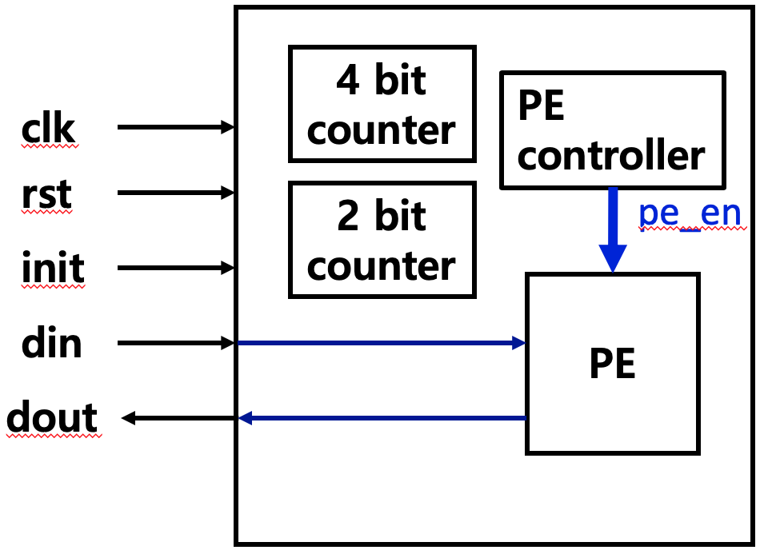
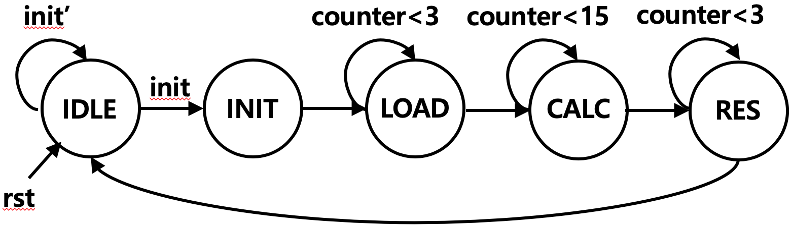
Example: Simple PE controller - continued
module pe_controller (clk, rst, init, din, dout);
input clk, rst, init;
input [31:0] din;
output [31:0] dout;
reg [1:0] present_state, next_state; // present state and next state
reg [3:0] count15; // register for counter
reg [1:0] count3;
reg counter_rst15;
reg counter_rst3;
reg pe_en; // enable for PE
parameter IDLE = 3'd0, INIT = 3'd1, LOAD = 3'd2, CALC = 3'd3, RES = 3'd4;
// PE
PE my_pe (
.clk(clk),
.rst(rst),
.en(pe_en),
.din(din),
.dout(dout)
);
// counter
always @(posedge clk or posedge counter_rst15)
if(counter_rst15) count15 <= 0;
else count15 <= count15+1;
always @(posedge clk or posedge counter_rst3)
if(counter_rst3) count3 <= 0;
else count3 <= count3+1;

Slide 23
Example: Simple PE controller
// part 1: initialize to state IDLE and update present state register
always @(posedge clk or posedge rst)
if(rst) present_state <= IDLE; else present_state <= next_state;
// part 2: determine next state
always @(*)
case(present_state)
IDLE: if(init) next_state = INIT; else next_state = present_state;
INIT: next_state = LOAD;
LOAD: if(count3==3) next_state = CALC; else next_state = present_state;
CALC: if(count15==15) next_state = RES; else next_state = present_state;
RES: if(count3==3) next_state = IDLE; else next_state = present_state;
endcase
// part 3: evaluate output (in this case internal registers)
always @(*)
case (present_state)
CALC: counter_rst15 = 0; // counter for CALC continues to tick
default: counter_rst15 = 1;
endcase
always @(*)
case (present_state)
LOAD: counter_rst3 = 0; // counter for LOAD continues to tick
RES: counter_rst3 = 0; // counter for RES continues to tick
default: counter_rst3 = 1;
endcase
always @(*)
case (present_state)
IDLE: pe_en = 0;
default: pe_en = 1;
endcase
endmodule

Slide 24
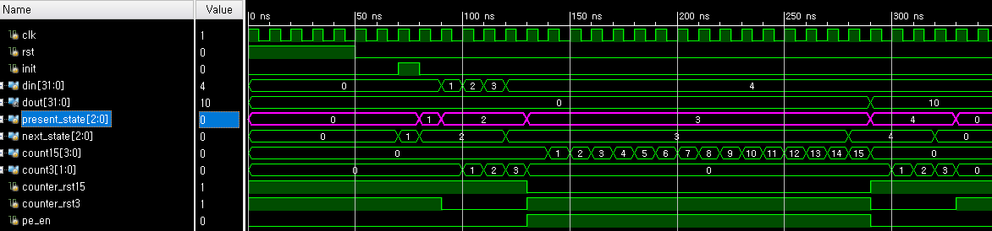
Example: Simple PE controller
init’
counter<3
counter<15
counter<3
init
IDLE
0
INIT
1
LOAD
2
CALC
3
RES
4
rst

Slide 25
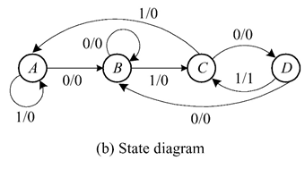
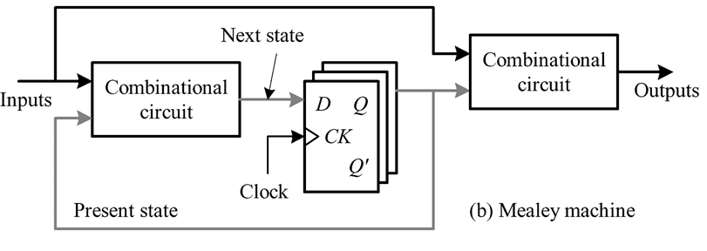
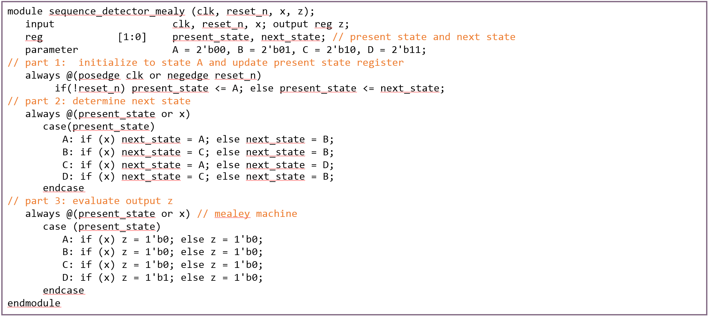
Logic Synthesizer
part 3
part 2
part 1

Slide 26
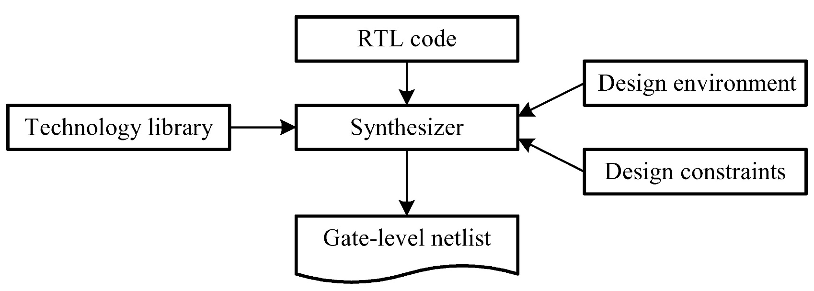
Logic Synthesis Environment
Design environment
Design constraints
RTL code
Technology library

Slide 27
Design Constraints
Include clock, input delay and output delay
E.g., 100MHz, every input/output has 0.5ns delay
Clock signal specification
Period : clock period
Duty cycle : proportion of time during which a component is operated
Transition time : rise time and fall time of the clock
Skew : clock network delay
Delay specifications
Maximum
Minimum

Slide 28
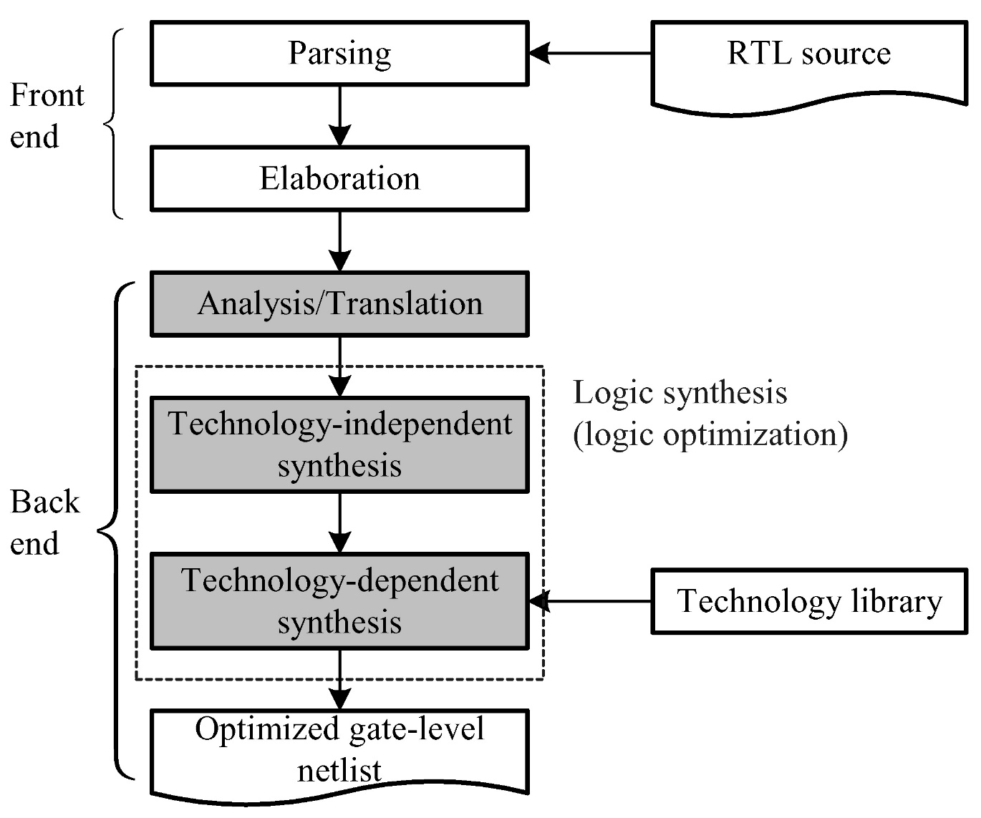
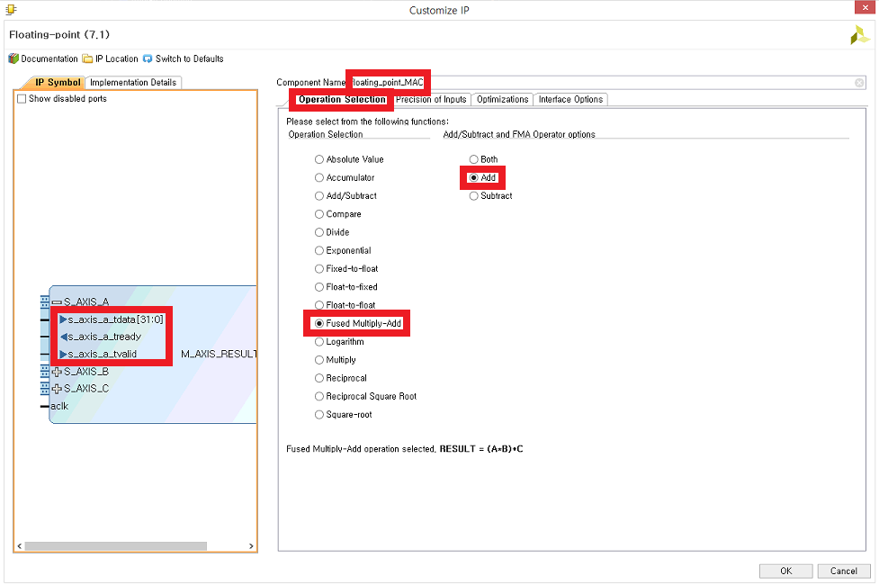
Flow in Synthesizer
Like a selection from IP catalog

Slide 29
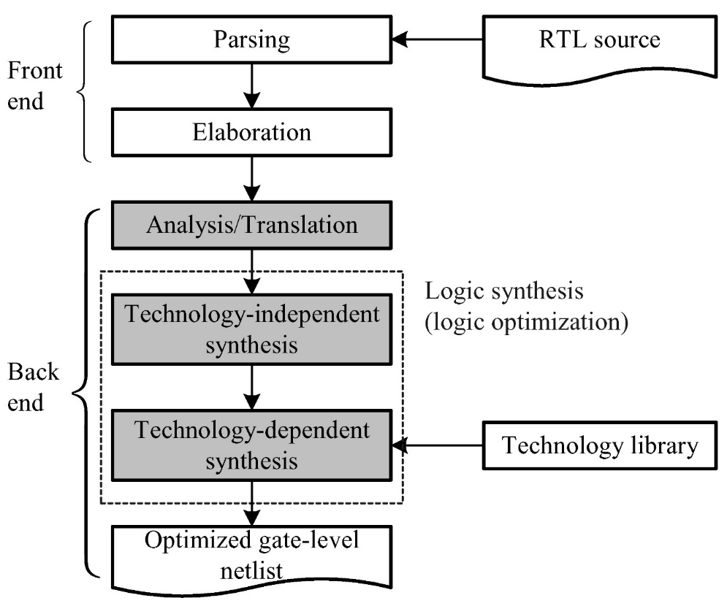
The Architecture of Synthesizer
Front end
Parsing phase
Check the syntax of the source code
Create internal components
Elaboration phase
Connect the internal components
Unroll loops & expand generate-loops
Set up parameters passing for tasks and functions
→ Complete description of the input circuit

Slide 30
Writing Synthesizable Code
Synthesizable operators
Synthesizable constructs
assignment statement
if .. else statement
case statement
loop structures
always statement
Memory synthesis approaches

Slide 31
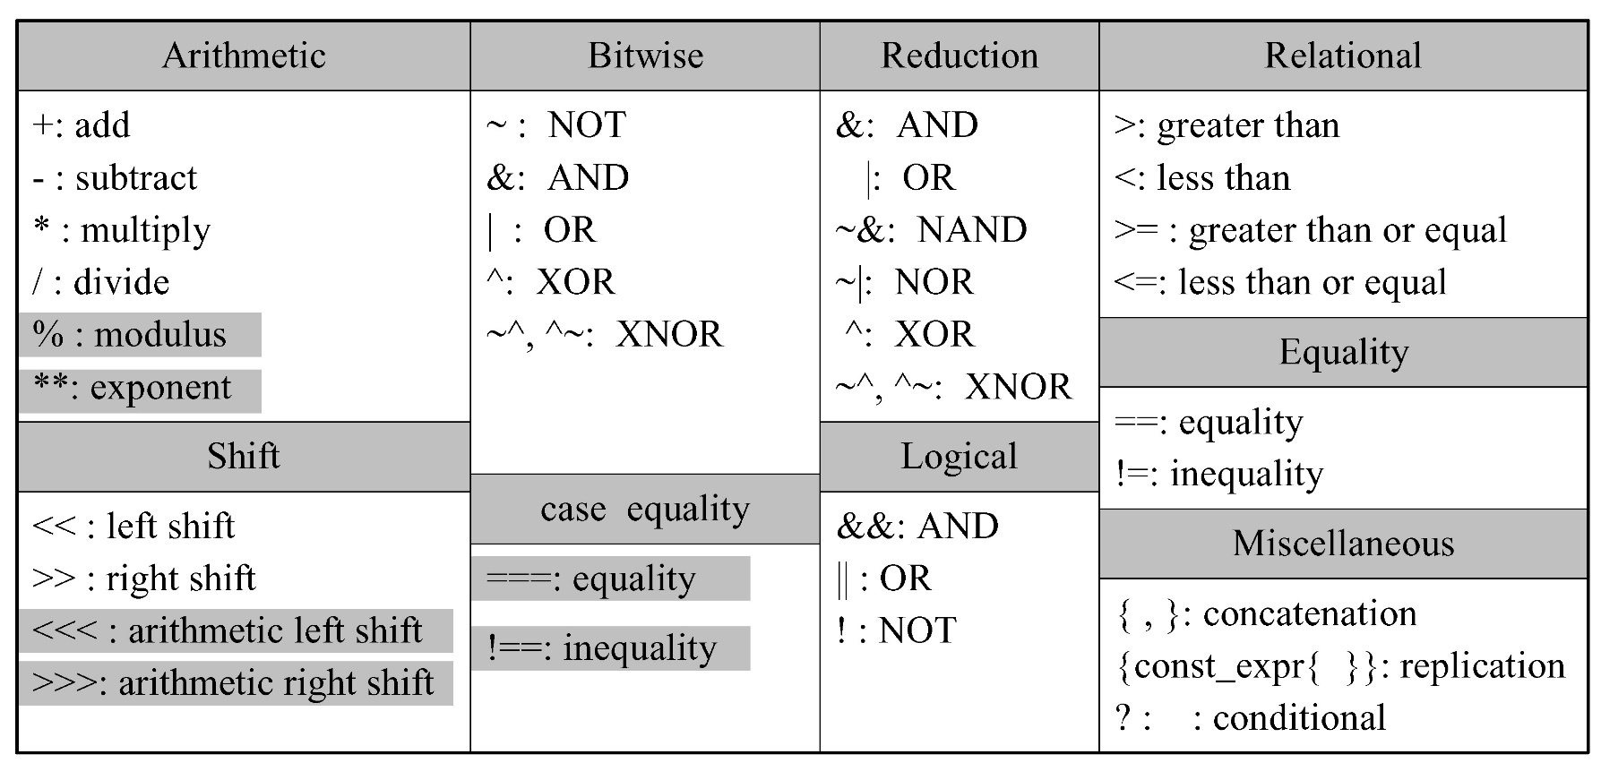
Synthesizable Operators
Analysis/translation step extracts the logical functions from a language structure
Operators with gray blocks are generally the exceptions for synthesis
Operands can be wire net type, reg variable type and parameter, as well as functions

Slide 32
Synthesizable if-else Statements
Usually synthesize into a 2-to-1 multiplexer
Nested if-else → priority-encoded, cascaded combination of multiplexers
For combinational logic
Completely specified?
always @(enable or data)
if (enable) y = data; //infer a latch
always @(enable or data)
if (enable) y = data;
else y = y; //infer a latch
always @(enable or data)
if (enable) y = data;
else y = x; //infer a mux

Slide 33
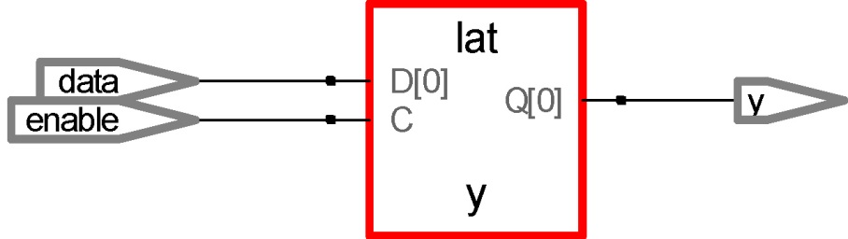
Latch Inference --- Incomplete if-else Statements
// creating a latch
module latch_infer_if(enable, data, y);
input enable, data;
output reg y;
always @(enable or data)
if (enable) y = data; // infer a latch for y

Slide 34
Synthesizable if-else Statements
For sequential logic
Completely specified?
Synthesis tool will remove the redundant expression
always @(posedge clk)
if (enable) y <= data;
else y <= y; // a redundant expression

Slide 35
Coding Style
Avoid using any latches in a design
Assign outputs for all input conditions to avoid inferred latches
Two ways to avoid latch inference:
always @(enable or data)
y = 1’b0; // initialize y to its initial value.
if (enable) y = data;
always @(enable or data)
if (enable) y = data;
else y = x; // complete if-else statement

Slide 36
Synthesizable case Statements
A case statement
Infers a multiplexer
Completely specified?

Slide 37
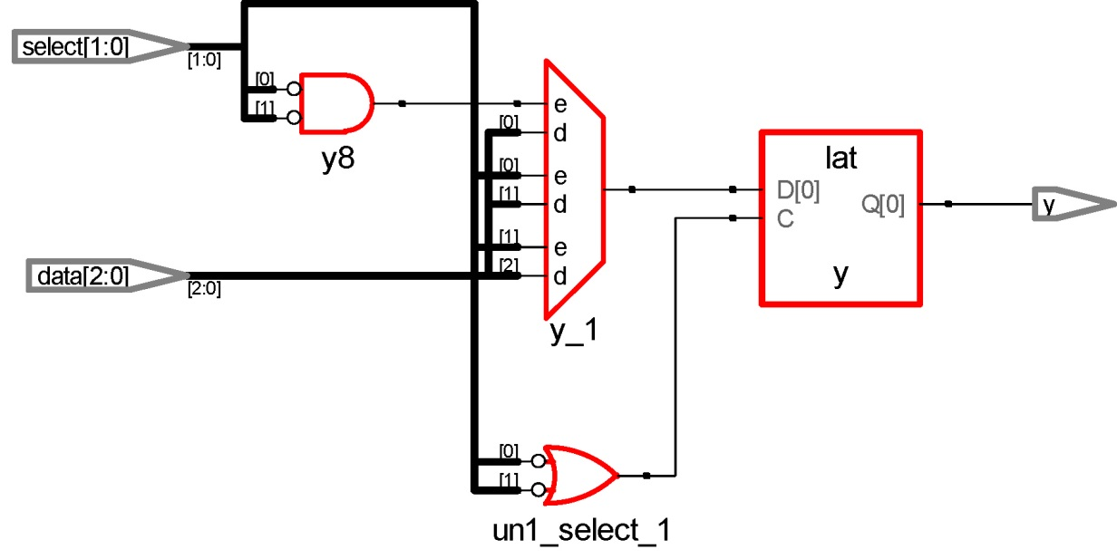
Latch Inference --- Incomplete Case Statements
// Creating a latch
module latch_infer_case(select, data, y);
…
output reg y;
always @(select or data)
case (select)
2'b00: y = data[select];
2'b01: y = data[select];
2'b10: y = data[select];
// infer a latch
endcase

Slide 38
Latch Inference --- Complete Case Statements
module mux(select, data, y);
…
output reg y;
always @(select or data)
case (select)
2'b00: y = data[select];
2'b01: y = data[select];
2'b10: y = data[select];
default: y = 2'b11; // mux
endcase

Slide 39
Mixed Use of posedge/level Signals
// the mixed usage of posedge and level signals
// the result cannot be synthesized
module DFF_bad (clk, reset, d, q);
…
// the body of DFF
always @(posedge clk or reset)
begin
if (reset) q <= 1'b0;
else q <= d;
end
Error: Do not mix posedge/negedge use with plain(level) signal references

Slide 40
Mixed Use of posedge/negedge Signals
// the mixed usage of posedge/negedge signal
module DFF_good (clk, reset_n, d, q);
…
// the body of DFF
always @(posedge clk or negedge reset_n)
begin
if (!reset_n) q <= 1'b0;
else q <= d;
end
*Not recommended

Slide 41
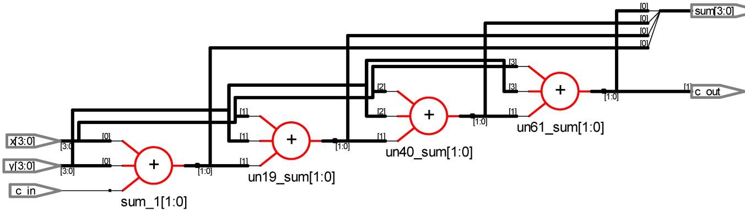
Loop Structures
Loop statements for, while, and forever are synthesizable except that while and forever must contain timing control @(posedge clk) or @(negedge clk)
repeat is generally not synthesizable
// an N-bit adder using for loop.
module nbit_adder_for( x, y, c_in, sum, c_out);
parameter N = 4; // default size
…
integer i;
…
always @(x or y or c_in) begin
co = c_in;
for (i = 0; i < N; i = i + 1)
{co, sum[i]} = x[i] + y[i] + co; // At the elaboration phase, the always block is expanded into the following statements
c_out = co;
end

Slide 42
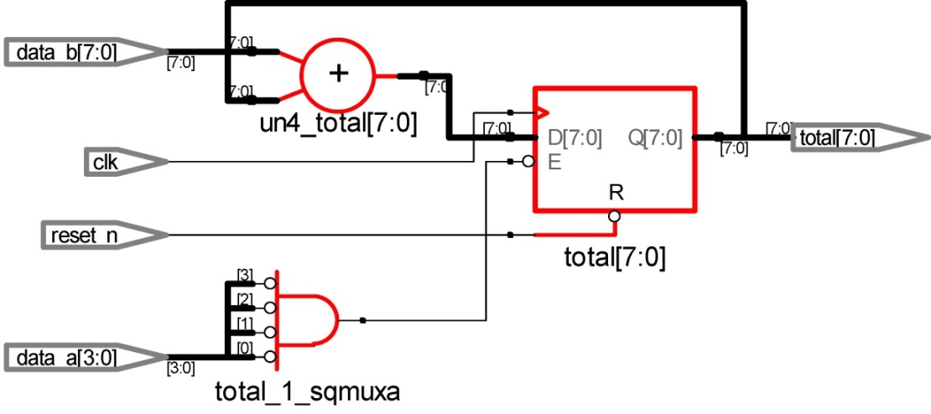
Loop Structures - An Incorrectly Synthesizable Example
// a multiple cycle example --- This is an incorrect version.
…
parameter N = 8;
parameter M = 4;
input clk, reset_n;
…
integer i;
// what does the following statement do?
always @(posedge clk or negedge reset_n) begin
if (!reset_n) total <= 0;
else for (i = 0; i < M; i = i + 1)
if (data_a[i] == 1) total <= total + data_b;
end
Q: Why the synthesized result is like this? Due to the non-blocking statement!

Slide 43
Loop Structures - An Incorrectly Synthesizable Example
// a multiple cycle example --- This is an incorrect version.
…
parameter N = 8;
parameter M = 4;
input clk, reset_n;
…
integer i;
// what does the following statement do?
always @(posedge clk or negedge reset_n) begin
if (!reset_n) total <= 0;
else begin
if (data_a[0] == 1) total <= total + data_b;
if (data_a[1] == 1) total <= total + data_b;
if (data_a[2] == 1) total <= total + data_b;
if (data_a[3] == 1) total <= total + data_b;
end
end

Slide 44
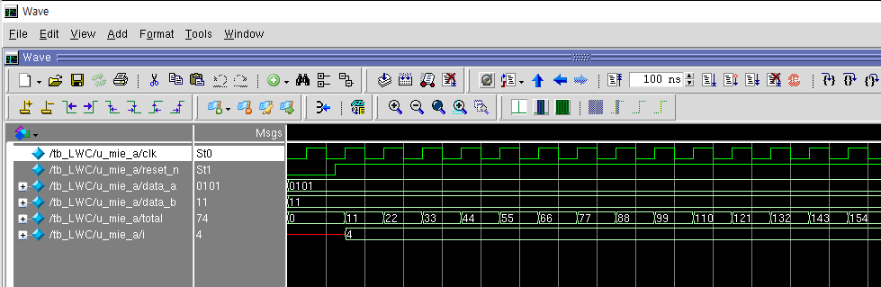
Loop Structures - An Incorrectly Synthesizable Example

Slide 45
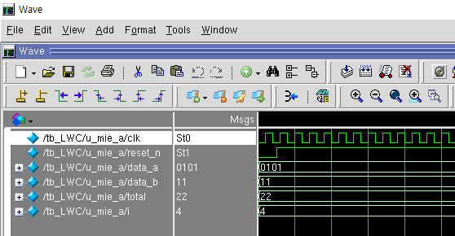
Loop Structures - An Correctly Synthesizable Example
// a multiple cycle example --- This is an correct version.
…
parameter N = 8;
parameter M = 4;
input clk, reset_n;
…
integer i;
always @(*) begin
total = 0;
for (i = 0; i < M; i = i + 1)
if (data_a[i] == 1) total = total + data_b;
end

Slide 46
The Architecture of Synthesizer
Back end
Analysis/translation
Include managing the design hierarchy
Extract the FSM
Explore resource sharing
Logic synthesis (logic optimization)
Create a new gate network computing the functions specified by a set of Boolean functions, one per primary output
Balance a number of concerns : functional metric and non-functional metric (area, power, delay)
Netlist generation

Slide 47
Logic Optimization
FSM optimization in sequential circuit
State minimization in FSM + input/output/state encoding + combinational circuit optimization
part 3
part 2
part 1
# states → # F/Fs

Slide 48
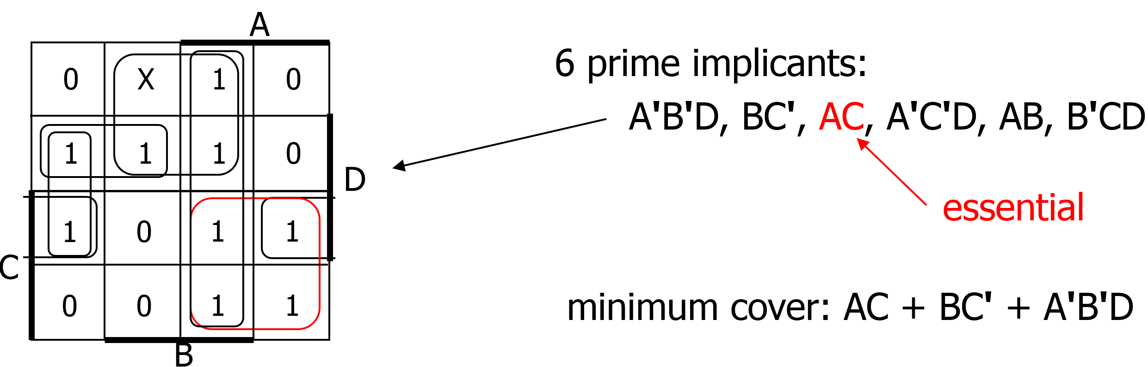
Logic Optimization
Combinational circuit
E.g., Minimum cover selection on K-map

Slide 49
Algorithmic Approach to State Minimization
Goal – identify and combine states that have equivalent behavior
Equivalent States: Same output & Same transition
Same output
For all input combinations, states transition to same or equivalent states
Row Matching Method: Algorithm Sketch
1. Place all states in one set
2. Initially partition set based on output behavior
3. Successively partition resulting subsets based on next state transitions
4. Repeat (3) until no further partitioning is required
states left in the same set are equivalent
Polynomial time procedure

Slide 50
State Minimization Example
Sequence Detector for 010 or 110
Input Next State Output
Sequence Present State X=0 X=1 X=0 X=1
Reset S0 S1 S2 0 0
0 S1 S3 S4 0 0
1 S2 S5 S6 0 0
00 S3 S0 S0 0 0
01 S4 S0 S0 1 0
10 S5 S0 S0 0 0
11 S6 S0 S0 1 0
S0
0/0
1/0
S1
S2
0/0
1/0
0/0
1/0
S3
S4
S5
S6
1/0
1/0
1/0
1/0
0/0
0/1
0/0
0/1

Slide 51
Method of Successive Partitions
Input Next State Output
Sequence Present State X=0 X=1 X=0 X=1
Reset S0 S1 S2 0 0
0 S1 S3 S4 0 0
1 S2 S5 S6 0 0
00 S3 S0 S0 0 0
01 S4 S0 S0 1 0
10 S5 S0 S0 0 0
11 S6 S0 S0 1 0
A
A
A
B
A
B
A
A
A
A
A
A
A
A
( S0 S1 S2 S3 S4 S5 S6 )
( S0 S1 S2 S3 S5 ) ( S4 S6 )
( S0 S3 S5 ) ( S1 S2 ) ( S4 S6 )
( S0 ) ( S3 S5 ) ( S1 S2 ) ( S4 S6 )
A
B

Slide 52
Method of Successive Partitions
Input Next State Output
Sequence Present State X=0 X=1 X=0 X=1
Reset S0 S1 S2 0 0
0 S1 S3 S4 0 0
1 S2 S5 S6 0 0
00 S3 S0 S0 0 0
01 S4 S0 S0 1 0
10 S5 S0 S0 0 0
11 S6 S0 S0 1 0
A
A
A
B
A
B
A
A
A
A
A
A
A
A
( S0 S1 S2 S3 S4 S5 S6 )
( S0 S1 S2 S3 S5 ) ( S4 S6 )
( S0 S3 S5 ) ( S1 S2 ) ( S4 S6 )
( S0 ) ( S3 S5 ) ( S1 S2 ) ( S4 S6 )
A
B

Slide 53
Method of Successive Partitions
Input Next State Output
Sequence Present State X=0 X=1 X=0 X=1
Reset S0 S1 S2 0 0
0 S1 S3 S4 0 0
1 S2 S5 S6 0 0
00 S3 S0 S0 0 0
01 S4 S0 S0 1 0
10 S5 S0 S0 0 0
11 S6 S0 S0 1 0
A
A
A
B
A
B
A
A
A
A
A
A
A
A
( S0 S1 S2 S3 S4 S5 S6 )
( S0 S1 S2 S3 S5 ) ( S4 S6 )
( S0 S3 S5 ) ( S1 S2 ) ( S4 S6 )
( S0 ) ( S3 S5 ) ( S1 S2 ) ( S4 S6 )
A
B

Slide 54
Method of Successive Partitions
Input Next State Output
Sequence Present State X=0 X=1 X=0 X=1
Reset S0 S1 S2 0 0
0 S1 S3 S4 0 0
1 S2 S5 S6 0 0
00 S3 S0 S0 0 0
01 S4 S0 S0 1 0
10 S5 S0 S0 0 0
11 S6 S0 S0 1 0
D
D
C
E
C
E
C
C
C
C
C
C
C
C
( S0 S1 S2 S3 S4 S5 S6 )
( S0 S1 S2 S3 S5 ) ( S4 S6 )
( S0 S3 S5 ) ( S1 S2 ) ( S4 S6 )
( S0 ) ( S3 S5 ) ( S1 S2 ) ( S4 S6 )
C
D
E

Slide 55
Method of Successive Partitions
Input Next State Output
Sequence Present State X=0 X=1 X=0 X=1
Reset S0 S1 S2 0 0
0 S1 S3 S4 0 0
1 S2 S5 S6 0 0
00 S3 S0 S0 0 0
01 S4 S0 S0 1 0
10 S5 S0 S0 0 0
11 S6 S0 S0 1 0
D
D
C
E
C
E
C
C
C
C
C
C
C
C
( S0 S1 S2 S3 S4 S5 S6 )
( S0 S1 S2 S3 S5 ) ( S4 S6 )
( S0 S3 S5 ) ( S1 S2 ) ( S4 S6 )
( S0 ) ( S3 S5 ) ( S1 S2 ) ( S4 S6 )
C
D
E

Slide 56
Method of Successive Partitions
Input Next State Output
Sequence Present State X=0 X=1 X=0 X=1
Reset S0 S1 S2 0 0
0 S1 S3 S4 0 0
1 S2 S5 S6 0 0
00 S3 S0 S0 0 0
01 S4 S0 S0 1 0
10 S5 S0 S0 0 0
11 S6 S0 S0 1 0
D
D
C
E
C
E
C
C
C
C
C
C
C
C
( S0 S1 S2 S3 S4 S5 S6 )
( S0 S1 S2 S3 S5 ) ( S4 S6 )
( S0 S3 S5 ) ( S1 S2 ) ( S4 S6 )
( S0 ) ( S3 S5 ) ( S1 S2 ) ( S4 S6 )
S1 is equivalent to S2
S3 is equivalent to S5
S4 is equivalent to S6
C
D
E

Slide 57
Minimized FSM
State minimized sequence detector for 010 or 110
Input Next State Output
Sequence Present State X=0 X=1 X=0 X=1
Reset S0 S1' S1' 0 0
0 + 1 S1' S3' S4' 0 0
X0 S3' S0 S0 0 0
X1 S4' S0 S0 1 0
S0
S0
X/0
0/0
1/0
S1’
S1
S2
0/0
1/0
0/0
1/0
0/0
1/0
S3’
S4’
S3
S4
S5
S6
1/0
1/0
1/0
1/0
X/0
0/1
1/0
0/0
0/1
0/0
0/1
( S0 ) ( S3 S5 ) ( S1 S2 ) ( S4 S6 )

Slide 58
Minimized FSM
State minimized sequence detector for 010 or 110
Input Next State Output
Sequence Present State X=0 X=1 X=0 X=1
Reset S0 S1' S1' 0 0
0 + 1 S1' S3' S4' 0 0
X0 S3' S0 S0 0 0
X1 S4' S0 S0 1 0
S0
S0
X/0
0/0
1/0
S1’
S1
S2
0/0
1/0
0/0
1/0
0/0
1/0
S3’
S4’
S3
S4
S5
S6
1/0
1/0
1/0
1/0
X/0
0/1
1/0
0/0
0/1
0/0
0/1
( S0 ) ( S3 S5 ) ( S1 S2 ) ( S4 S6 )

Slide 59
Minimized FSM: A Simple Illustration
State minimized sequence detector for 010 or 110
Input Next State Output
Sequence Present State X=0 X=1 X=0 X=1
Reset S0 S1' S1' 0 0
0 + 1 S1' S3' S4' 0 0
X0 S3' S0 S0 0 0
X1 S4' S0 S0 1 0
S0
S0
X/0
0/0
1/0
S1’
S1
S2
0/0
1/0
0/0
1/0
0/0
1/0
S3’
S4’
S3’
S4’
X/0
0/1
1/0
X/0
0/1
1/0
( S0 ) ( S3 S5 ) ( S1 S2 ) ( S4 S6 )

Slide 60
Minimized FSM
State minimized sequence detector for 010 or 110
Input Next State Output
Sequence Present State X=0 X=1 X=0 X=1
Reset S0 S1' S1' 0 0
0 + 1 S1' S3' S4' 0 0
X0 S3' S0 S0 0 0
X1 S4' S0 S0 1 0
S0
State
Minimization!
S0
X/0
0/0
1/0
S1’
S1
S2
0/0
1/0
0/0
1/0
0/0
1/0
S3’
S4’
S3
S4
S5
S6
1/0
1/0
1/0
1/0
X/0
0/1
1/0
0/0
0/1
0/0
0/1

Slide 61
The Architecture of Synthesizer
Back end
Analysis/translation
Include managing the design hierarchy
Extract the FSM
Explore resource sharing
Logic synthesis (logic optimization)
Create a new gate network computing the functions specified by a set of Boolean functions, one per primary output
Balance a number of concerns : functional metric and non-functional metric (area, power, delay)
Netlist generation

Slide 62
Agenda
Lecture
PE controller overview
Synthesizable Verilog code
Logic optimization review
Introduction to the lab on Week 5
Designing the PE controller

